Slide 1
OBC
Shawn Thompson
Demi Vis

Slide 2
OBC Outline
Requirements
Concept of Operations
Subsystem Description
Development Environment/Tools
Theory of Operations
Bench-Test Development
Testing and Procedures

Slide 3
OBC Requirements
Name | Description
CPU | A designated CPU is to be included on the OBC board.
Acceptable Performance | The central processing unit should be capable of meeting the processing demands of the payload boards.
Shutdown Command | CubeSats with batteries shall have the capability to receive a transmitter shutdown command, as per Federal Communications Commission (FCC) regulation.
Deployment Delay | Delay Spacecraft operation minimum 30 minutes after removal from launch vehicle.
Identification Transmission | At a known time-intervals, transmit identification of Spacecraft. (ARRL)

Slide 4
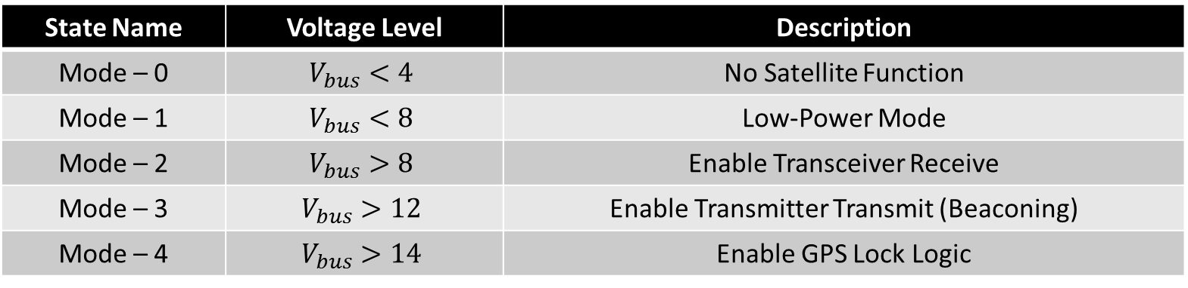

Concept Of Operations
Main Objective: To capture GPS position data and store for later downlink
Bus voltage driven logic
$V_{bus}$ is determined by a voltage divider on the EPS
State Name | Voltage Level | Description
Mode – 0 | $$V_{bus}<4$$ | No Satellite Function
Mode – 1 | $$V_{bus}<8$$ | Low-Power Mode
Mode – 2 | $$V_{bus}>8$$ | Enable Transceiver Receive
Mode – 3 | $$V_{bus}>12$$ | Enable Transmitter Transmit (Beaconing)
Mode – 4 | $$V_{bus}>14$$ | Enable GPS Lock Logic

Slide 5
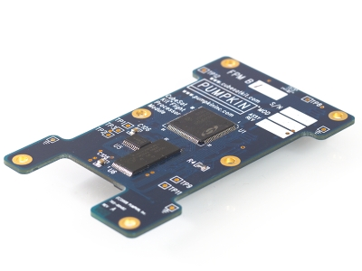
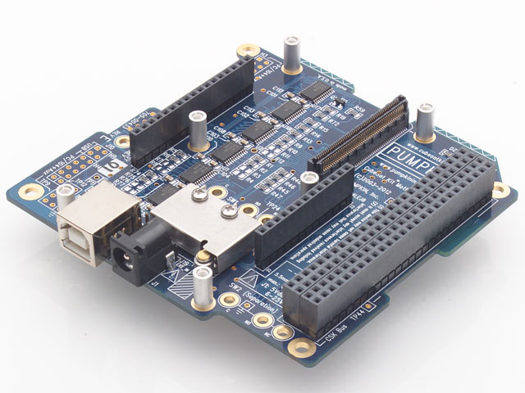
Subsystem Description - Hardware
Pluggable Processor Module by Pumpkin
  PIC24FJ - “eXtreme” Low-Power series
  Provides direct pin access for the motherboard
  Board Revision A
Flight Motherboard
  Provides programming/debugging interface
  Provides the interface to the CubeSat Kit Bus
  Integrated Real Time Calendar Clock (RTCC)
  Board Revision B

Slide 6

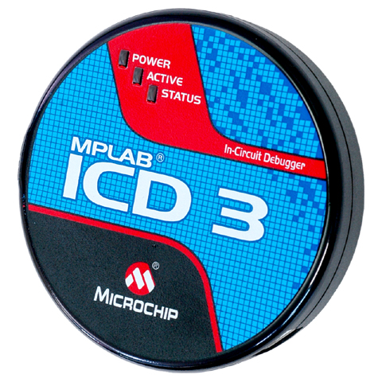
Development Environment/Tools
All software development tools provided by Microchip
  Software Developed in ANSI C
  IDE: MPLABX v3.10
  Compiler: XC16 v1.25
  Programming/Debug Interface: ICD3
Header files and libraries provided by Microchip

Slide 7
Theory of Operation
Interrupt Driven Design
  Six Interrupts to control software flow
  Power efficient and easy to debug
Interrupt Table
Interrupt Type | Interrupt Description
Analog Comparator | Eight volt trigger to turn off/on pertinent peripherals
Real Time Calendar Clock | Once-a-minute beacon that transmits satellite’s health and status data
GPIO – Energy Detect | Receive and parse a command from the Bell 202 Modem
GPIO – GPS Lock | GPS valid lock from pin on Novatel
Timer 1 | Manages GPS and COMMS subsystem communication and power
Timer 2 | GPS Lock Timeout – Two Minute Alarm

Slide 8
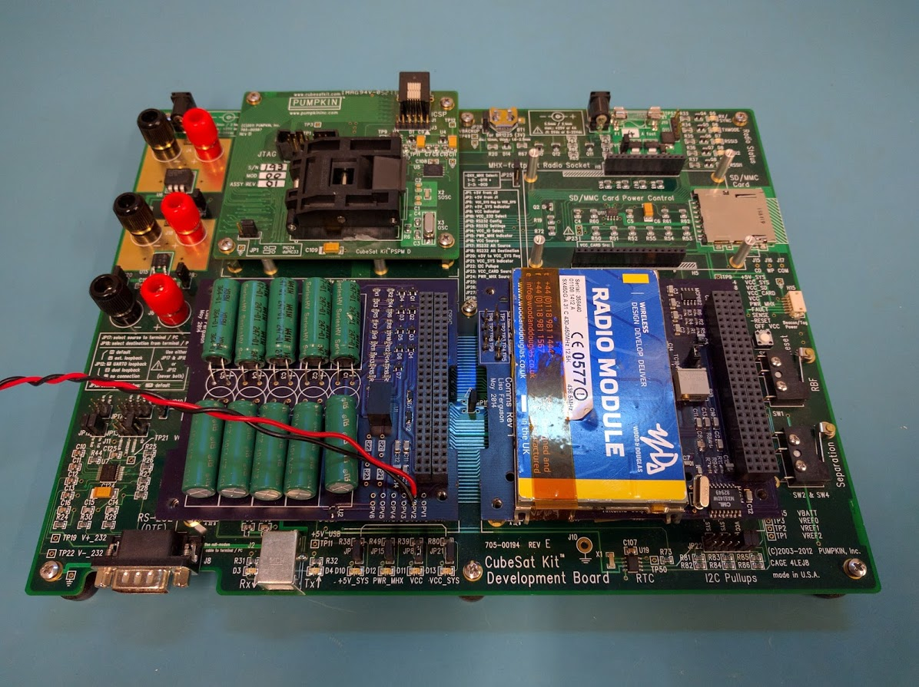
Bench-Test Development
Hardware testing provided by Pumpkin Development Board – Revision D
Identical bus design and hardware functionality
Error checking
  Test points
  Replaceable hardware
  LED status indicators

Slide 9
Testing and Procedures
First Cycle and Continuance:
  Description: Provide an accurate example of how the spacecraft functions on a typical basis with first flight procedure
  Procedure:
    Set power supply to a timer
    Monitor bus voltage
    Print status through UART for a period of time
Communications:
  Description: Determine the accuracy of receiving and transmitting with the implemented AX.25 protocol
  Procedure:
    Provide necessary voltages
    Transmit from ground station
    Monitor RSSI and valid packets received

Slide 10
OBC Summary
All Requirements Met
Prototype software to be thoroughly tested by Early April.

Slide 11
Backup Slides

Slide 12
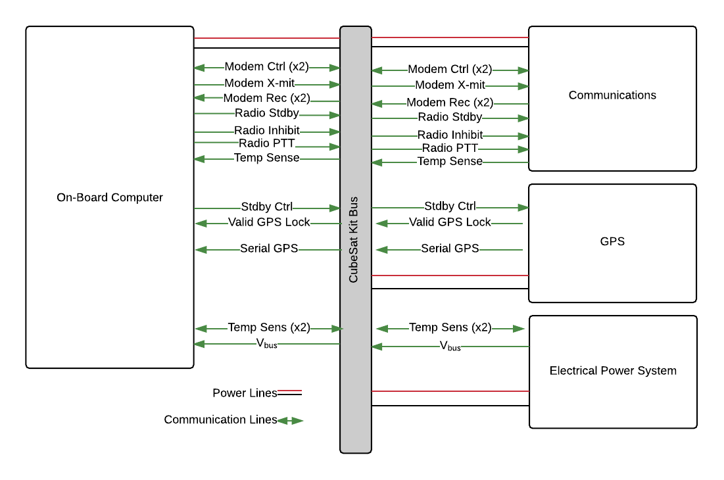
Mid-Level Connection Diagram

